Slide 1
Entity Framework Core
Code-First Approach

Slide 2
When to use Code- First?
When you have to make your application from scratch.
When you don’t have a readymade database.
You have to play with database frequently, like creating and deleting tables, views, and stored procedure.
When you have too many tables, views, and stored procedures in database.

Slide 3
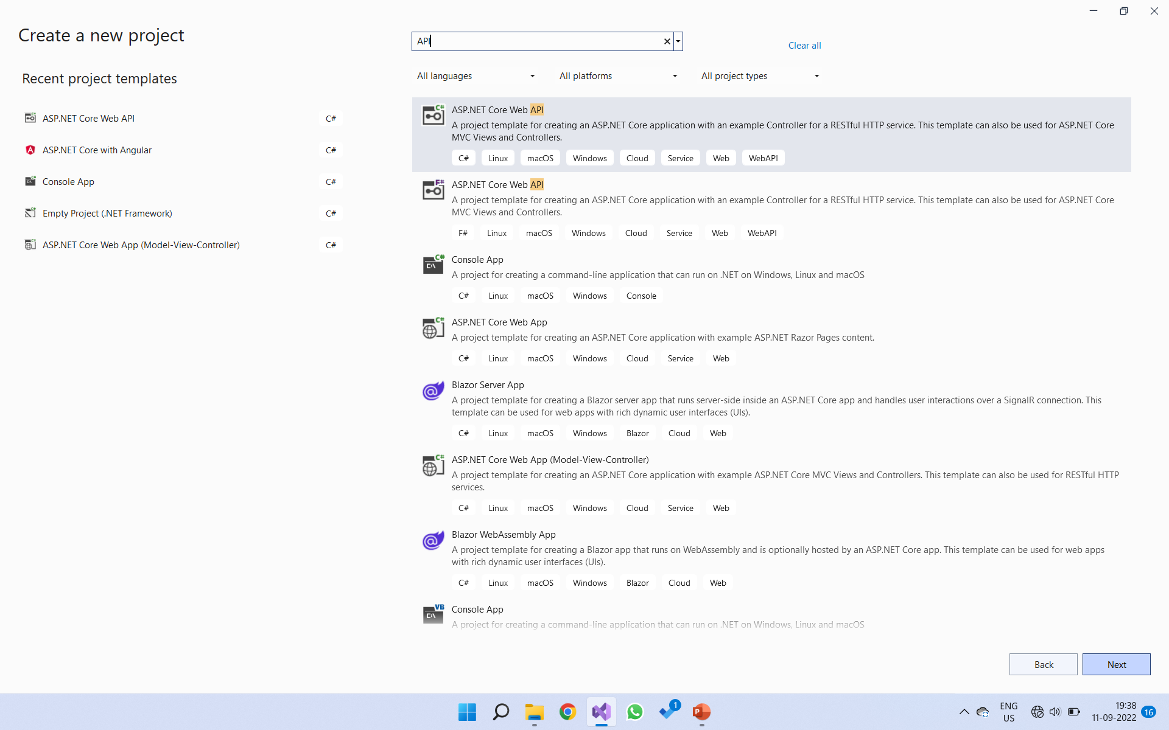
Open Visual Studio Editor.
In the Dashboard, select “Create a New Project”.
In the search box, type “API”.
From the list, select “ASP.NET Core Web API” With C#
Click on “Next” button

Slide 4
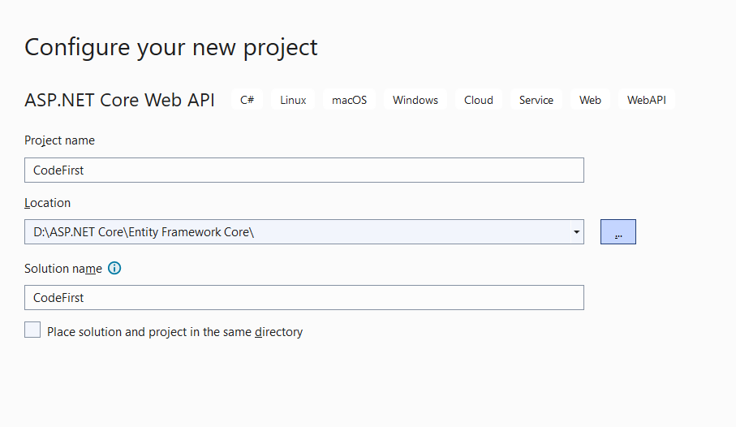
Now Enter Project name.
Select the location where you want to store the project
Click on Next button
After Clicking Next button, you will be taken to “Additional information” window.

Slide 5
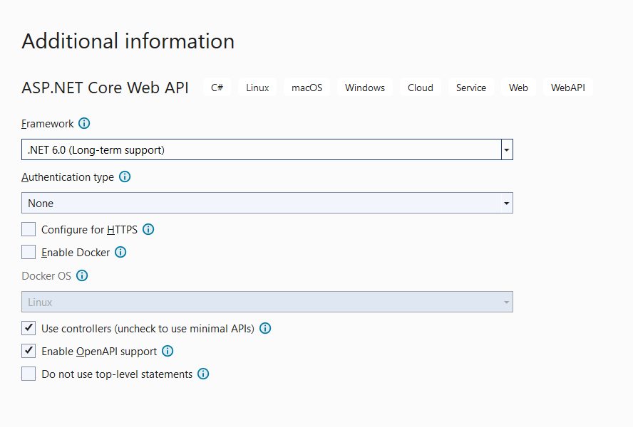
See the window below :
Make sure that “Configure for HTTPs” is unchecked. By default it is checked.
Select the Latest version of .NET Framework. In this project we have .NET 6.O
You can disable “Enable OpenAPI support” field also. But it is upto you. If it is checked, you will have Swagger UI for CRUD operations.
After that, click on “create” button.

Slide 6
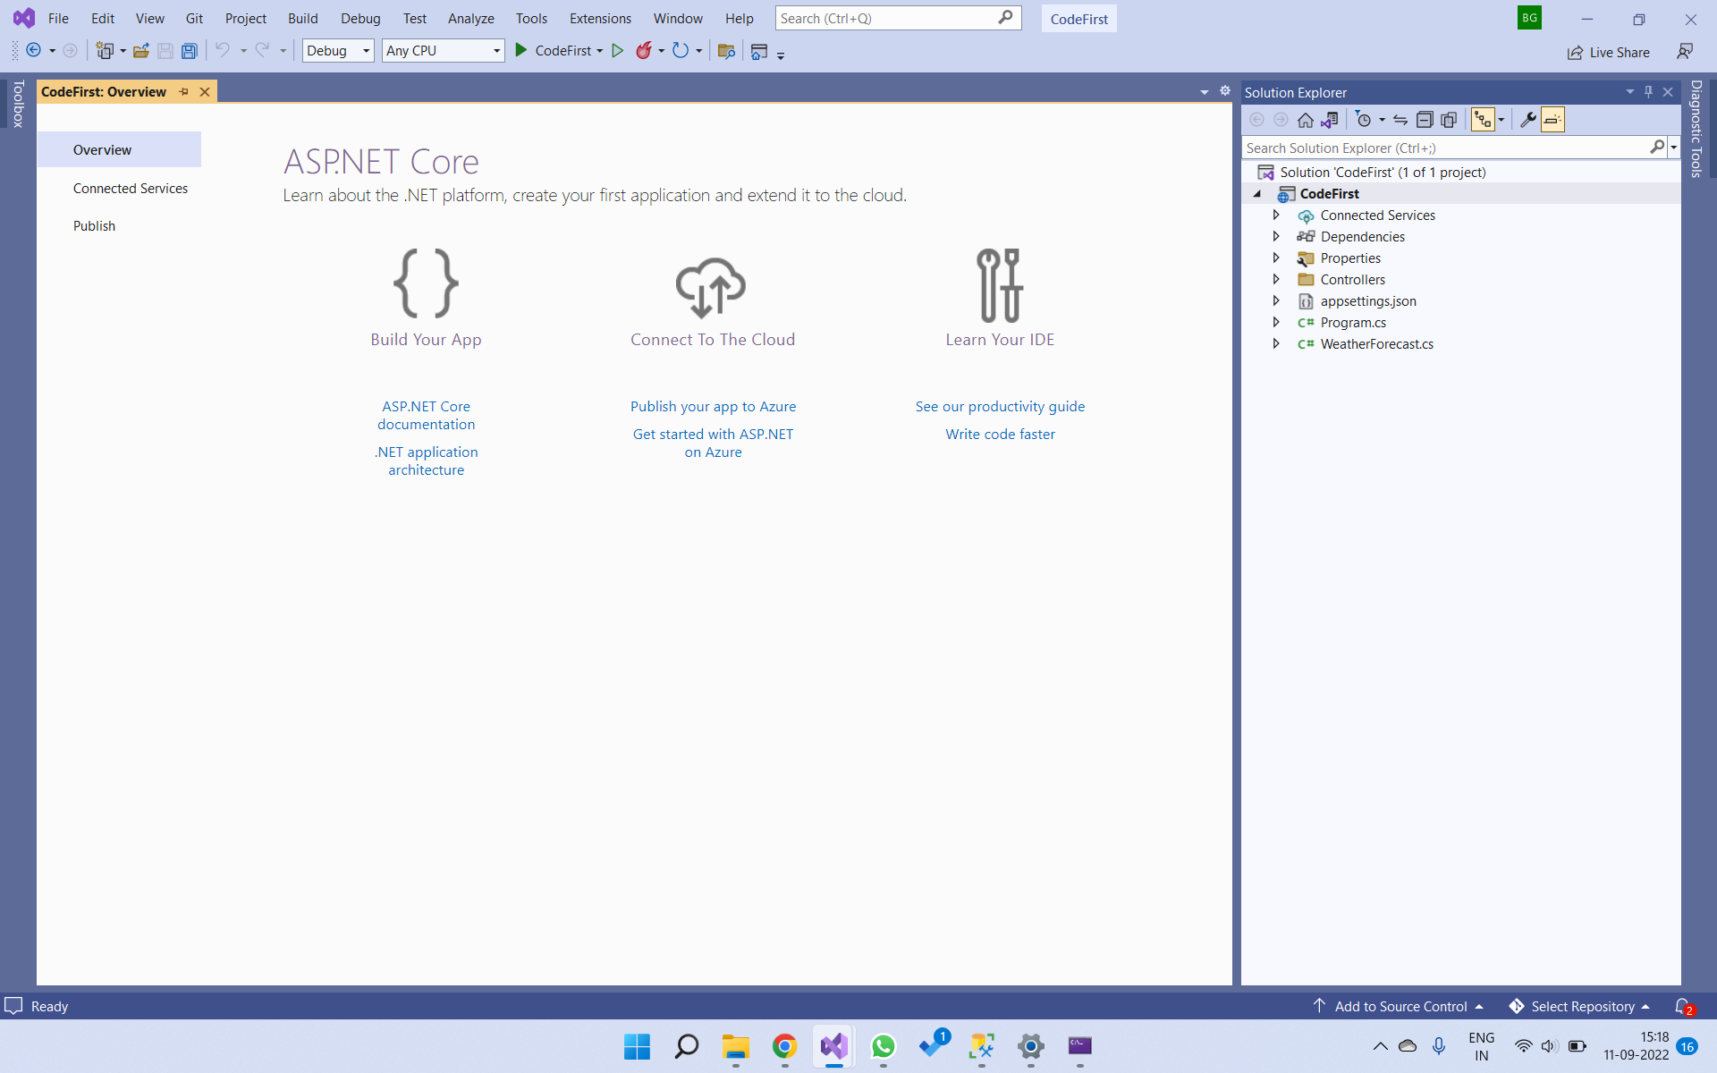

Slide 7
Environment Setup with NuGet Packages :
NuGet packages contain reusable code that other developers make available to you for use in your projects.
Introduction to NuGet :
For .NET and .NET Core, the Microsoft-supported mechanism for sharing code is NuGet, which defines how packages for .NET are created, hosted, and consumed, and provides the tools for each of those roles. Packages are installed into a Visual Studio project using the NuGet Package Manager, the Package Manager Console, or the dotnet CLI.
The NuGet Package Manager UI in Visual Studio on Windows allows you to easily install, uninstall, and update NuGet packages in projects and solutions.
First, we need to install the NuGet package for the provider of the database we want to access. Here, we want to access MS SQL Server database, so we need to install Microsoft.EntityFrameworkCore.SqlServer NuGet package.
To install the NuGet package, right click on the project in the Solution Explorer in Visual Studio and select Manage NuGet Packages.. (or select on the menu: Tools -> NuGet Package Manager -> Manage NuGet Packages For Solution).

Slide 8
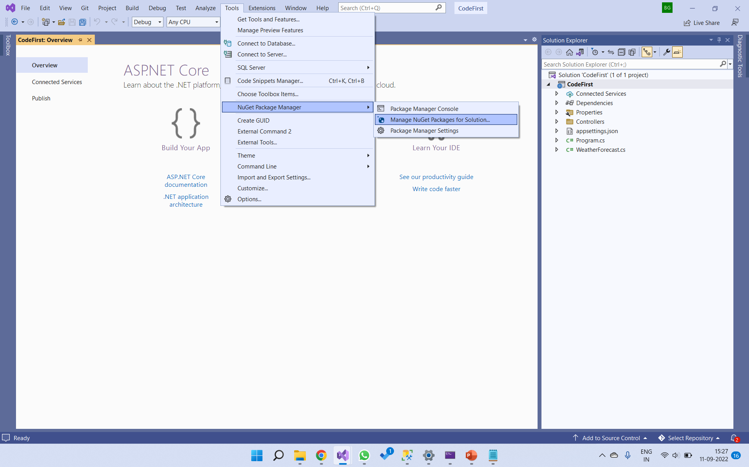

Slide 9
In the Browse Tab, Search for these 3 packages :
Microsoft.EntityFrameworkCore.SqlServer
Microsoft.EntityFrameworkCore.Tools
Microsoft.VisualStudio.Web.CodeGeneration.Design
You can also install these packages using Visual Studio Terminal :
“Install-Package Package_Name”
And you can also install these packages using .NET Core CLI :
“dotnet add package Package_Name”
Now let’s see the benefits of using these packages.

Slide 10
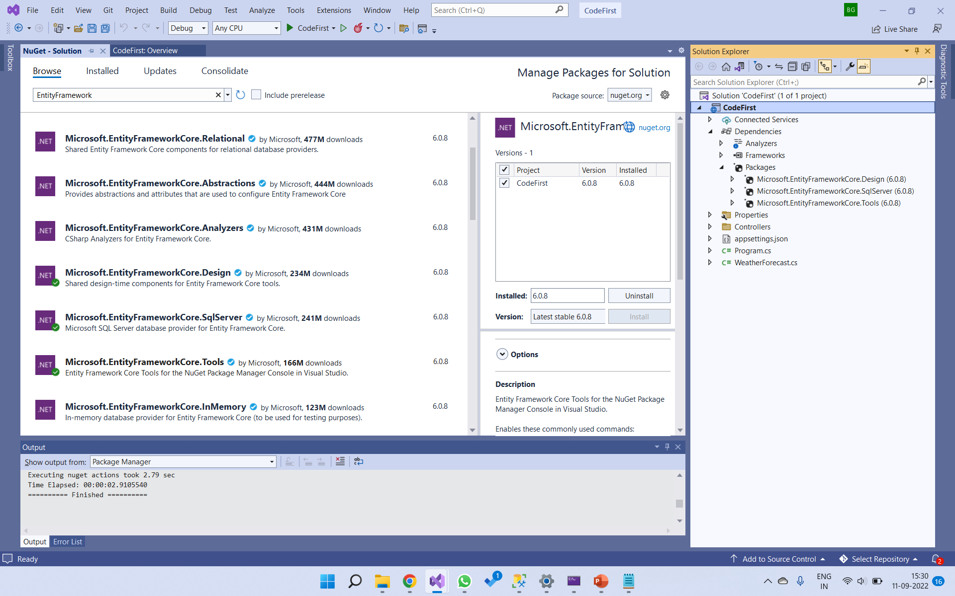
c
c

Slide 11
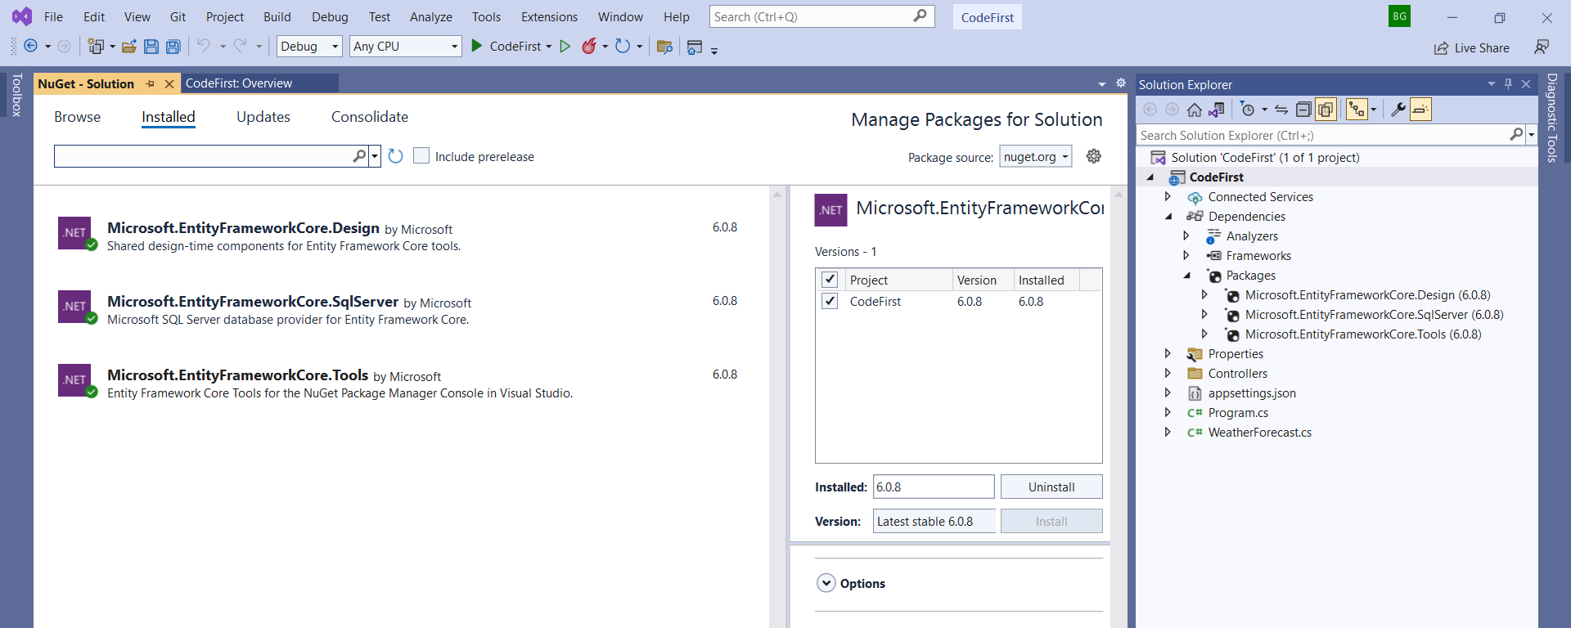
Check the packages in the Installed tab :

Slide 12
Microsoft.EntityFrameworkCore.SqlServer :
Microsoft.EntityFrameworkCore.SqlServer database provider allows Entity Framework Core to be used with Microsoft SQL Server (including SQL Azure).
Microsoft.VisualStudio.Web.CodeGeneration.Design :
Microsoft.EntityFrameworkCore.Design contains all the design-time logic for Entity Framework Core.
Microsoft.EntityFrameworkCore.Tools :
Microsoft.EntityFrameworkCore.Tools is used for design-time development tasks. They're primarily used to manage Migrations and to scaffold a DbContext and entity types by reverse engineering the schema of a database.
It enables these commonly used commands:
Add-Migration | Get-Migration | Bundle-Migration | Script-Migration
Remove--Migration | Update-Database | Drop-Database | Get-DbContext
Optimize-DbContext | Scaffold-DbContext

Slide 13
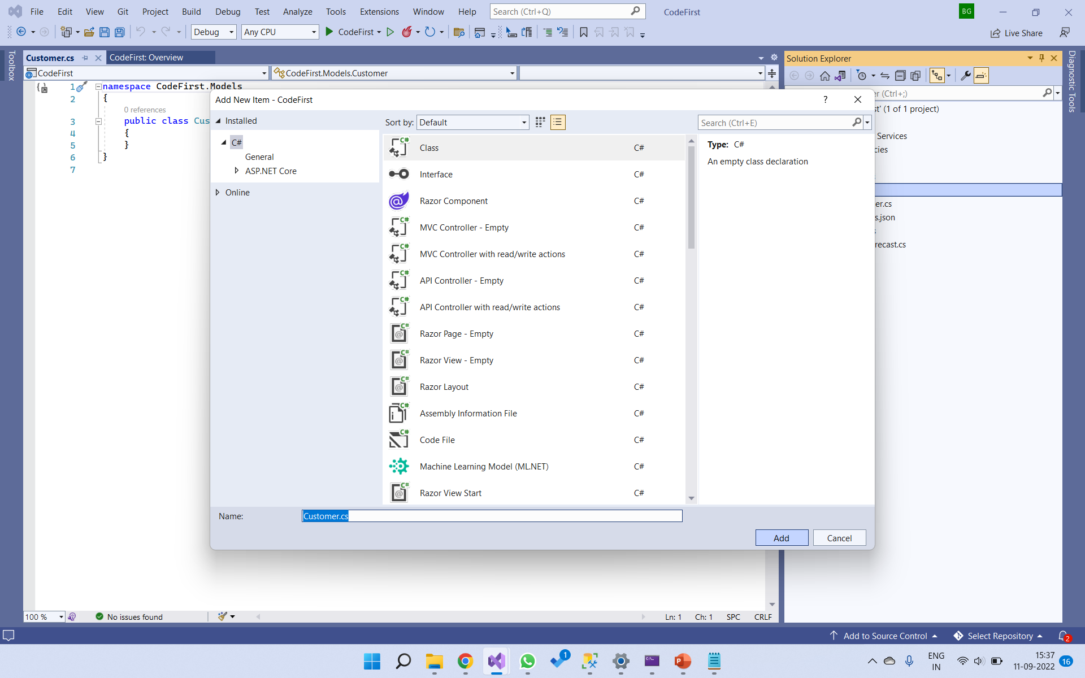
Now we have to create to model class for our entity. So first create a folder named Models.
Click on Models folder and select New Item.
Select C# class file. Give name to that class file “Customer” as shown in below.

Slide 14
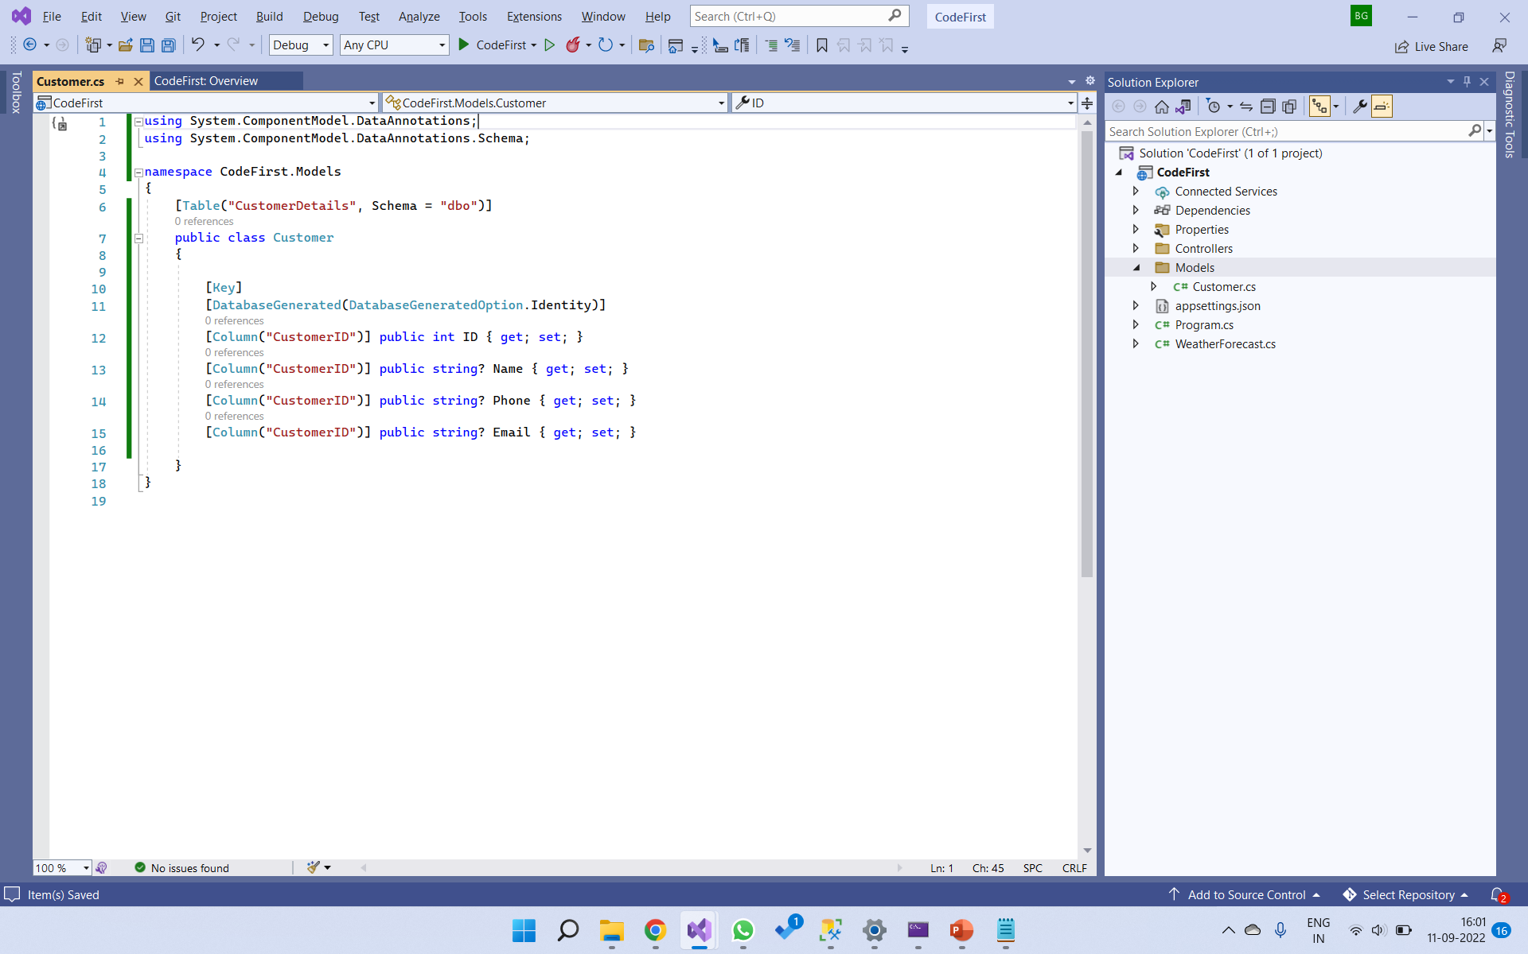
Now add the below code in the Customer.cs file.
For the entity class, we can use table attribute for mentioning the table name and the schema in the database.
We can also provide Column attriute to mention a custom column name.
Here we providing column attribute for other all properties as well.
Now in Customer class we need four properties :
1. ID ( Unique )
2. Name
3. Phone
4. Email
we have added the attribute [DatabaseGenerated(DaabaseGeneratedOption.Identity)] to denote that the column generates the value automatically upon insert.

Slide 15
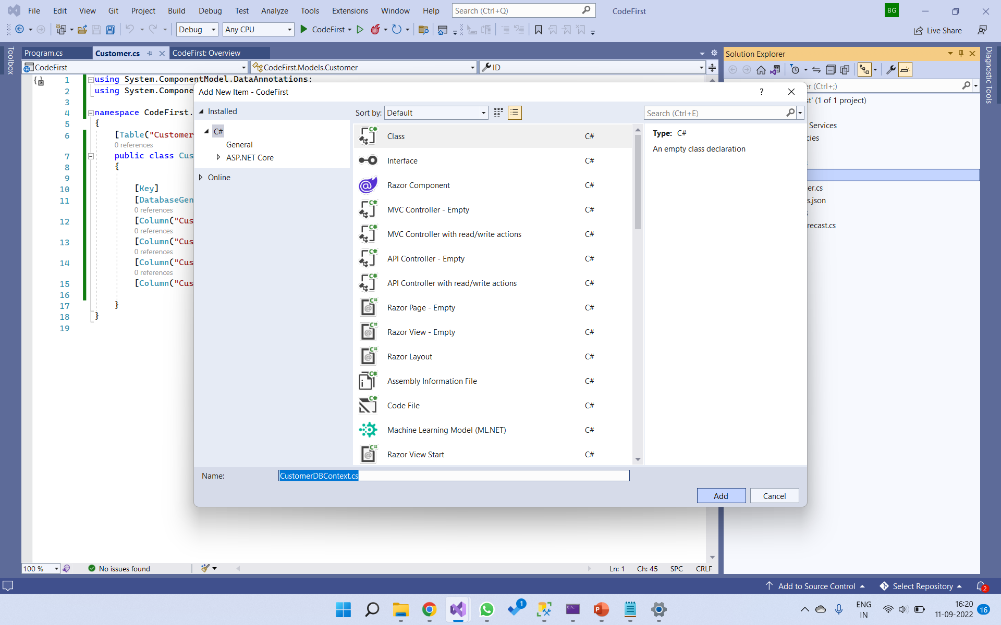
Now we need to create dbContext file. For that, right click on Models folder and select C# class file and name it as a CustomerDBContext.
As shown in below :

Slide 16
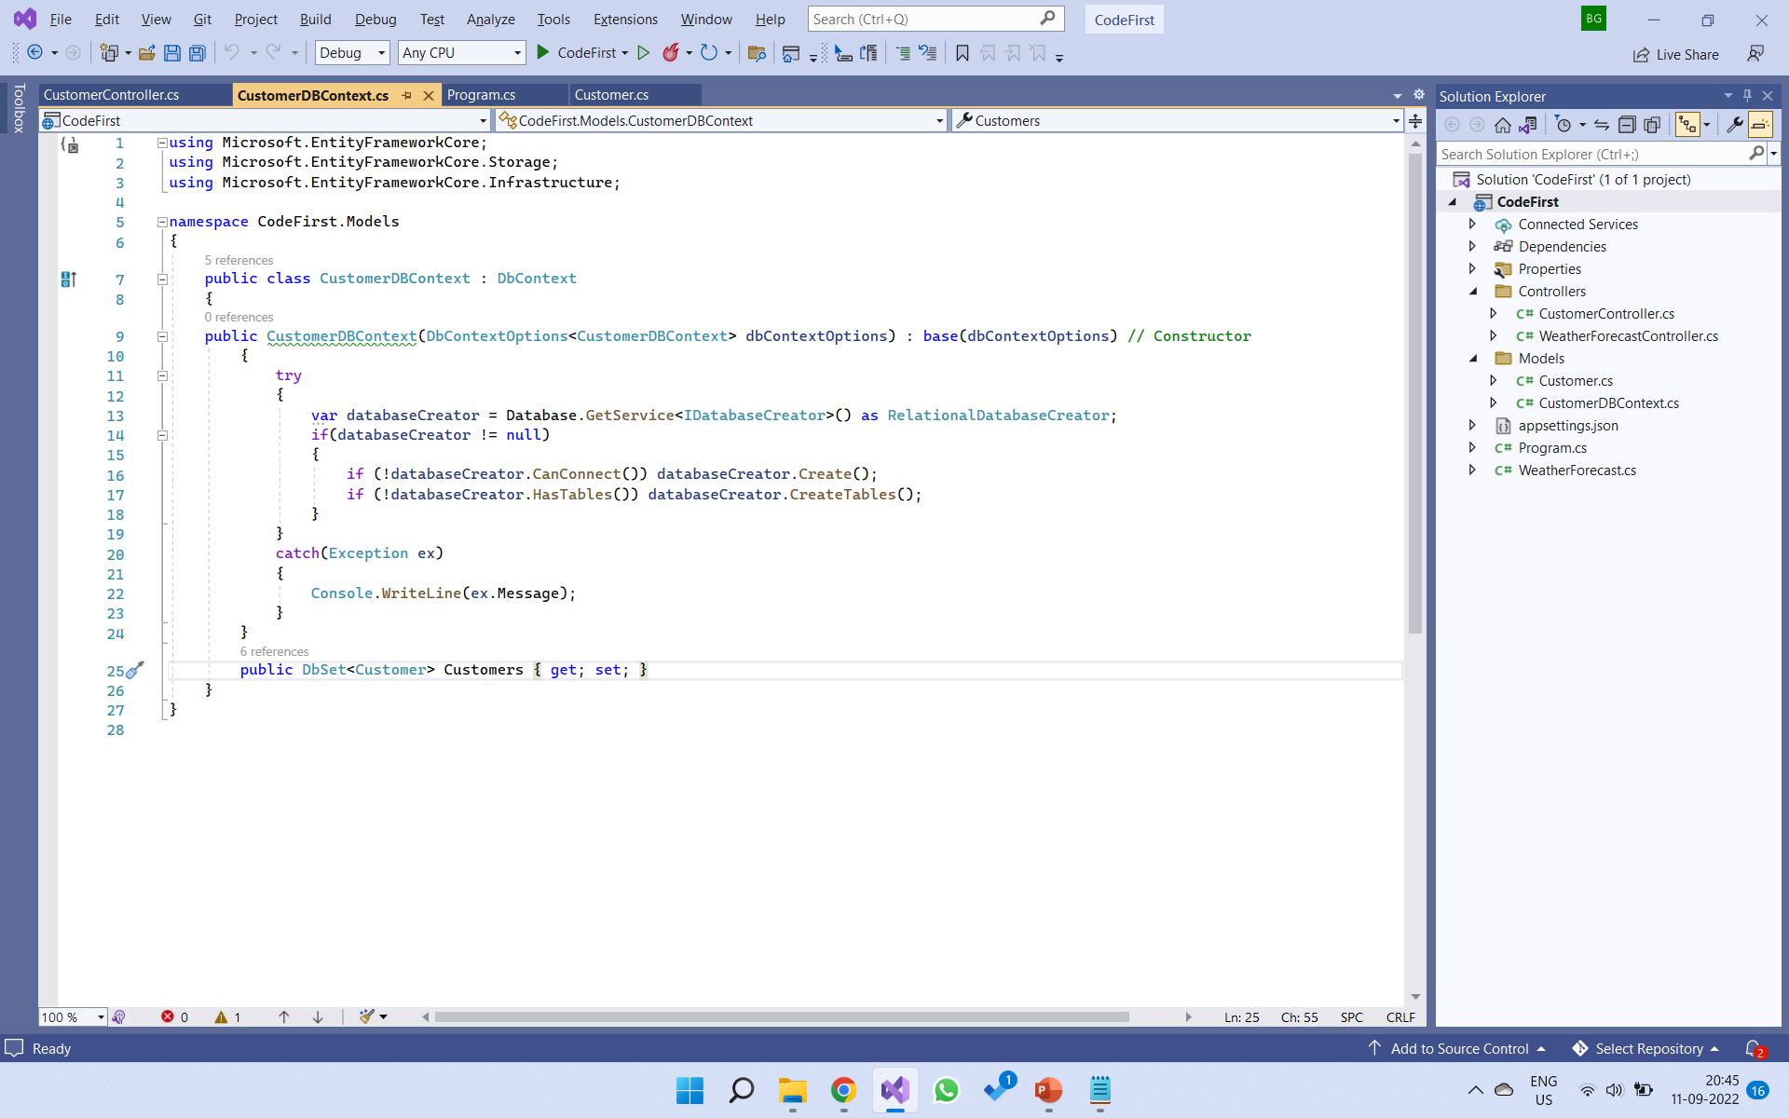
Now in the CustomerDBContext file, write this code

Slide 17
Now let’s understand the code.
The DbContext class is an integral part of Entity Framework. An instance of DbContext represents a session with the database which can be used to query and save instances of your entities to a database.
DbContext in EF Core allows us to perform following tasks :
Manage database connection
Configure model & relationship
Querying database
Saving data to the database
Configure change tracking
Caching
Transaction management
To use DbContext in our application, we need to create the class ( In our case i.e., CustomerDBContext ) that derives from DbContext, also known as context class. This context class typically includes DbSet<TEntity> properties for each entity in the model.
public class CustomerDBContext : DbContext

Slide 18
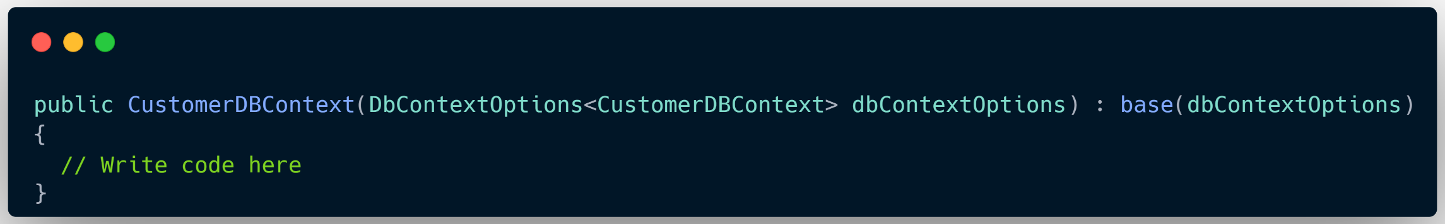
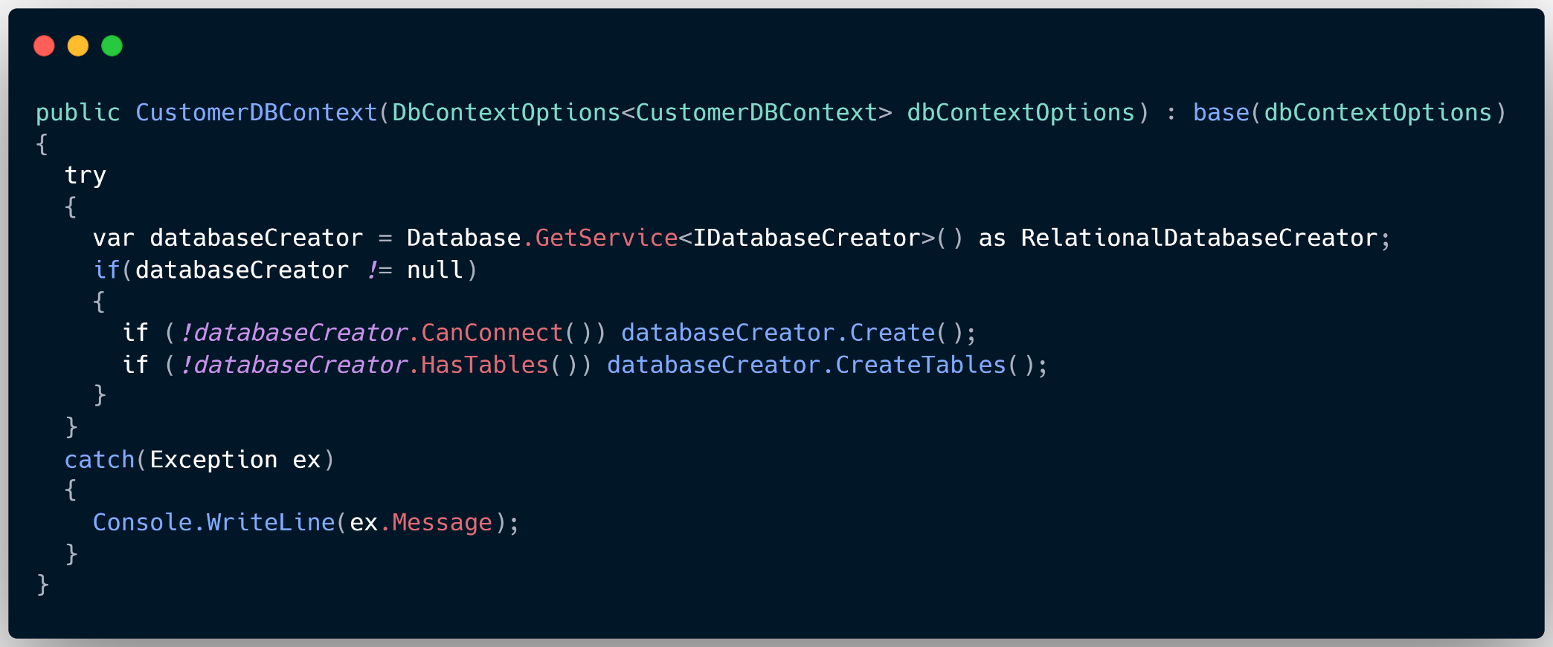
We have created a constructor for this class and provided dbContextOptions as parameter. It should also call the base class constructor to which we can pass dbContextOptions as the parameter. The dbContextOptions carries the configuration information needed to configure the DbContext.

Slide 19
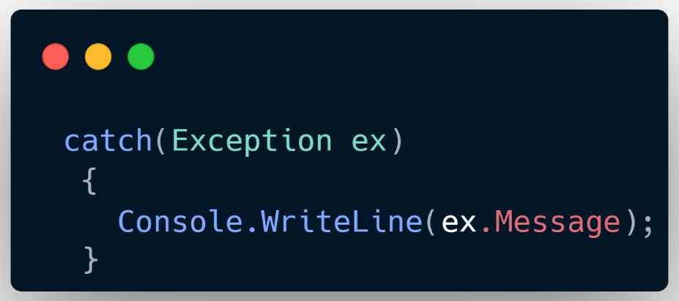
Now inside the constructor we provided a try/catch block method. Now inside the catch block, we wrote the following code.
We wrote a Console statement to log the error message it it occurs.
Next in the try block we created a databaseCreator object which we needed to use for creating the database if it doesn’t exist.
Then we added if conditional statement to check whether the databaseCreator object is not null.
If it is not null, we are creating a database if the databaseCreator object cannot connect to the database.
Next we are creating the database tables if the database is not having any tables in it.
That’s it needed in the constructor.
Next we are declared dbSet for Customer entity.
And we name it as Customers.
Now we can use this dbContext class in our dependency injection in Program.cs as shown in below.

Slide 20
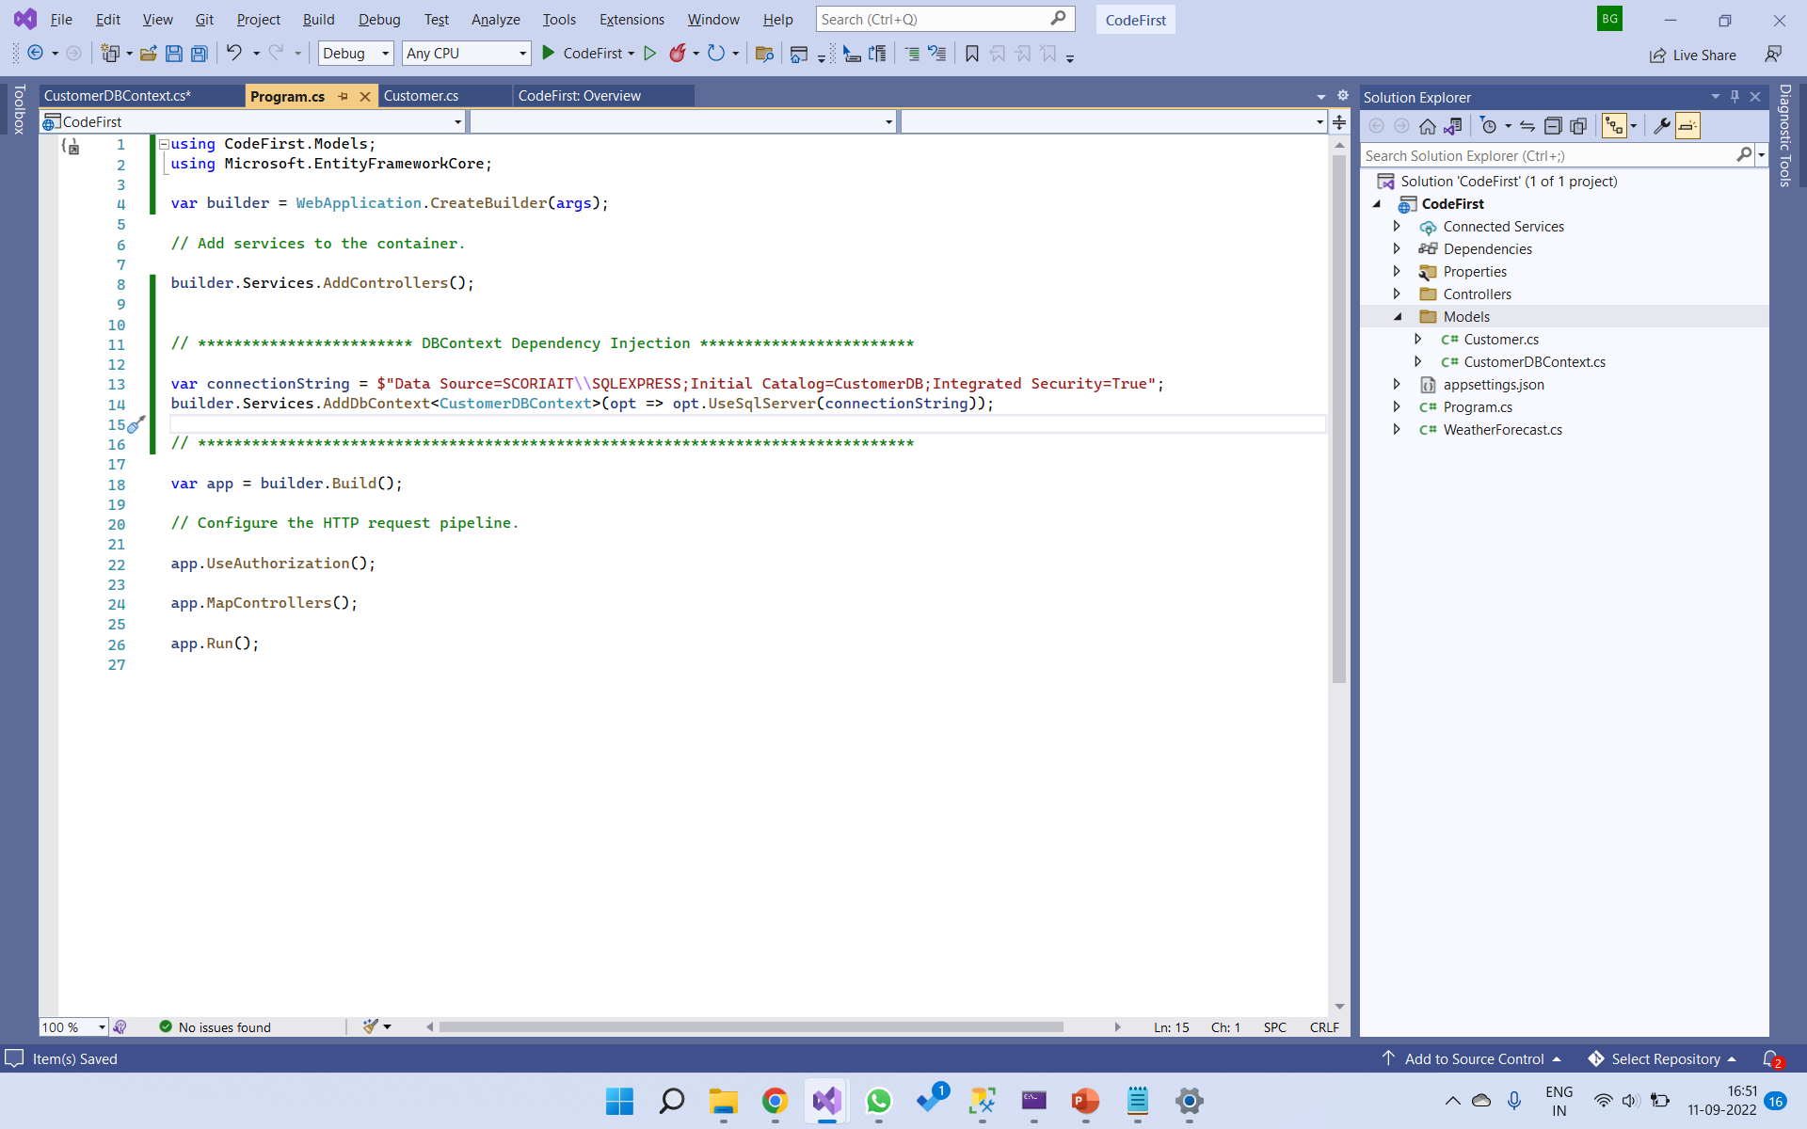
We want our database name should be CustomerDB. So we gave it in Initial catalog.

Slide 21
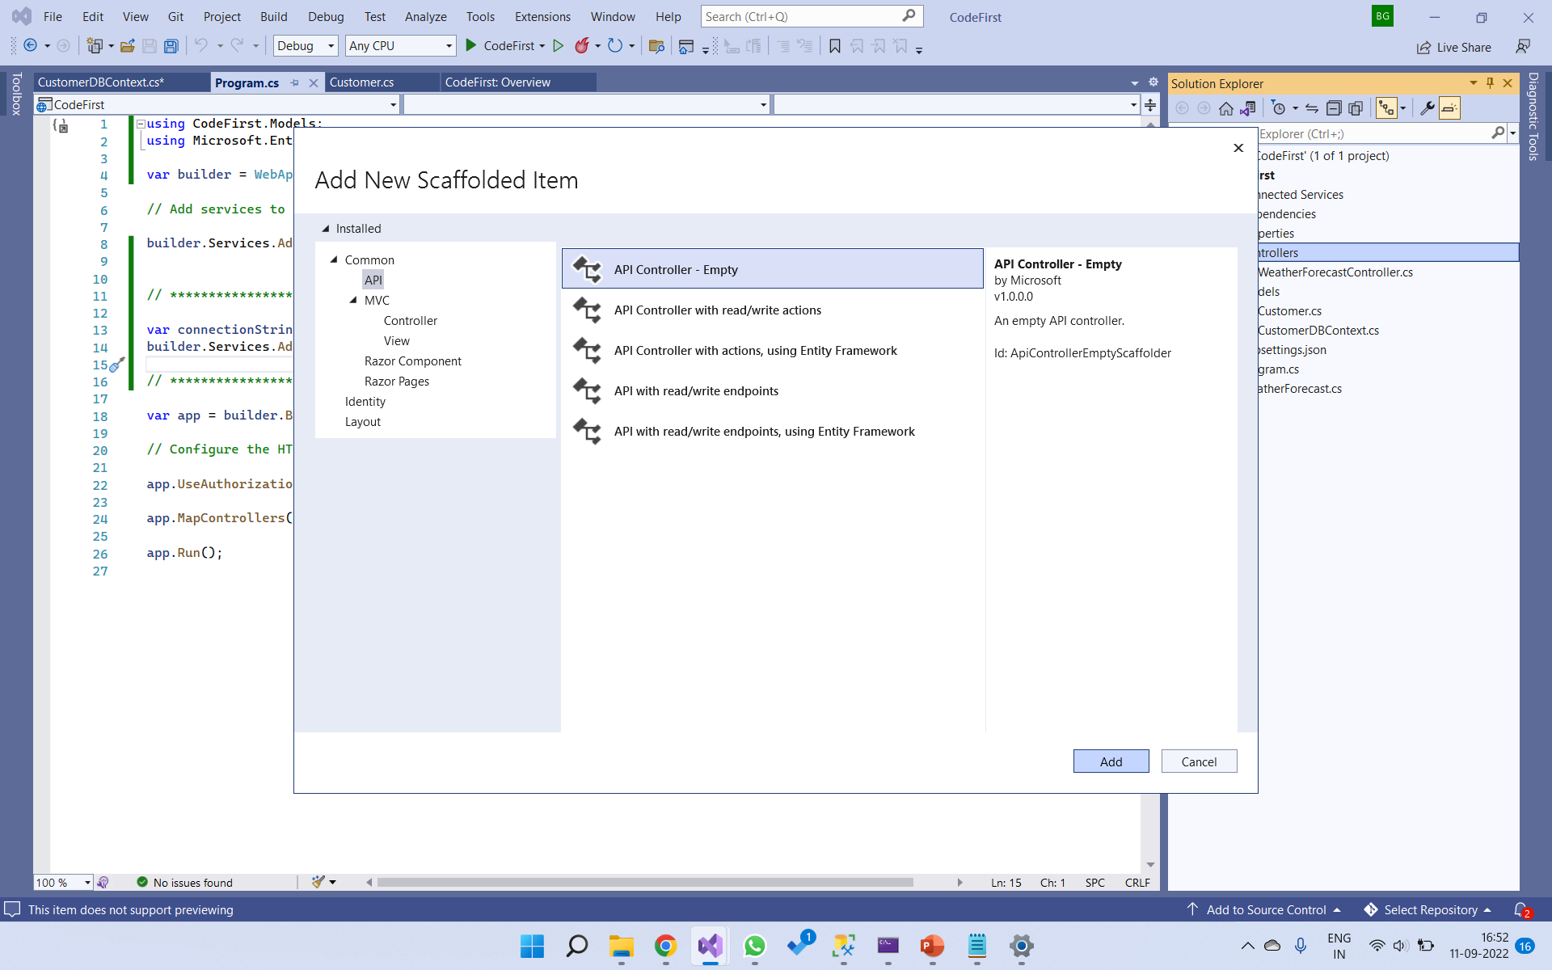
Now lets create an API controller.
Right click on Controllers folder and select Controller option. Select Empty API controller.
Click on Add button.

Slide 22
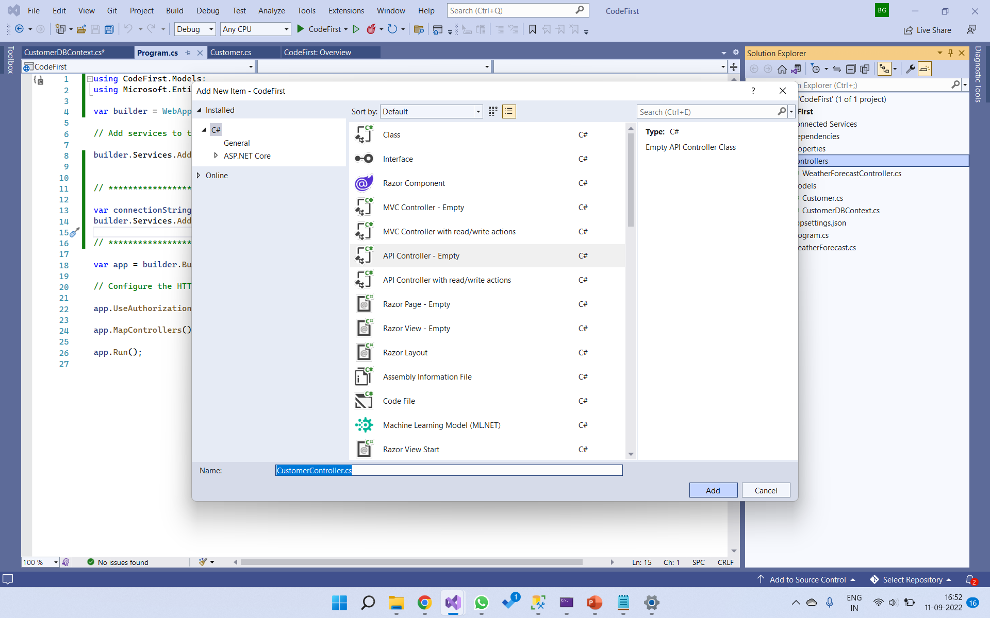
Create CustomerController class

Slide 23
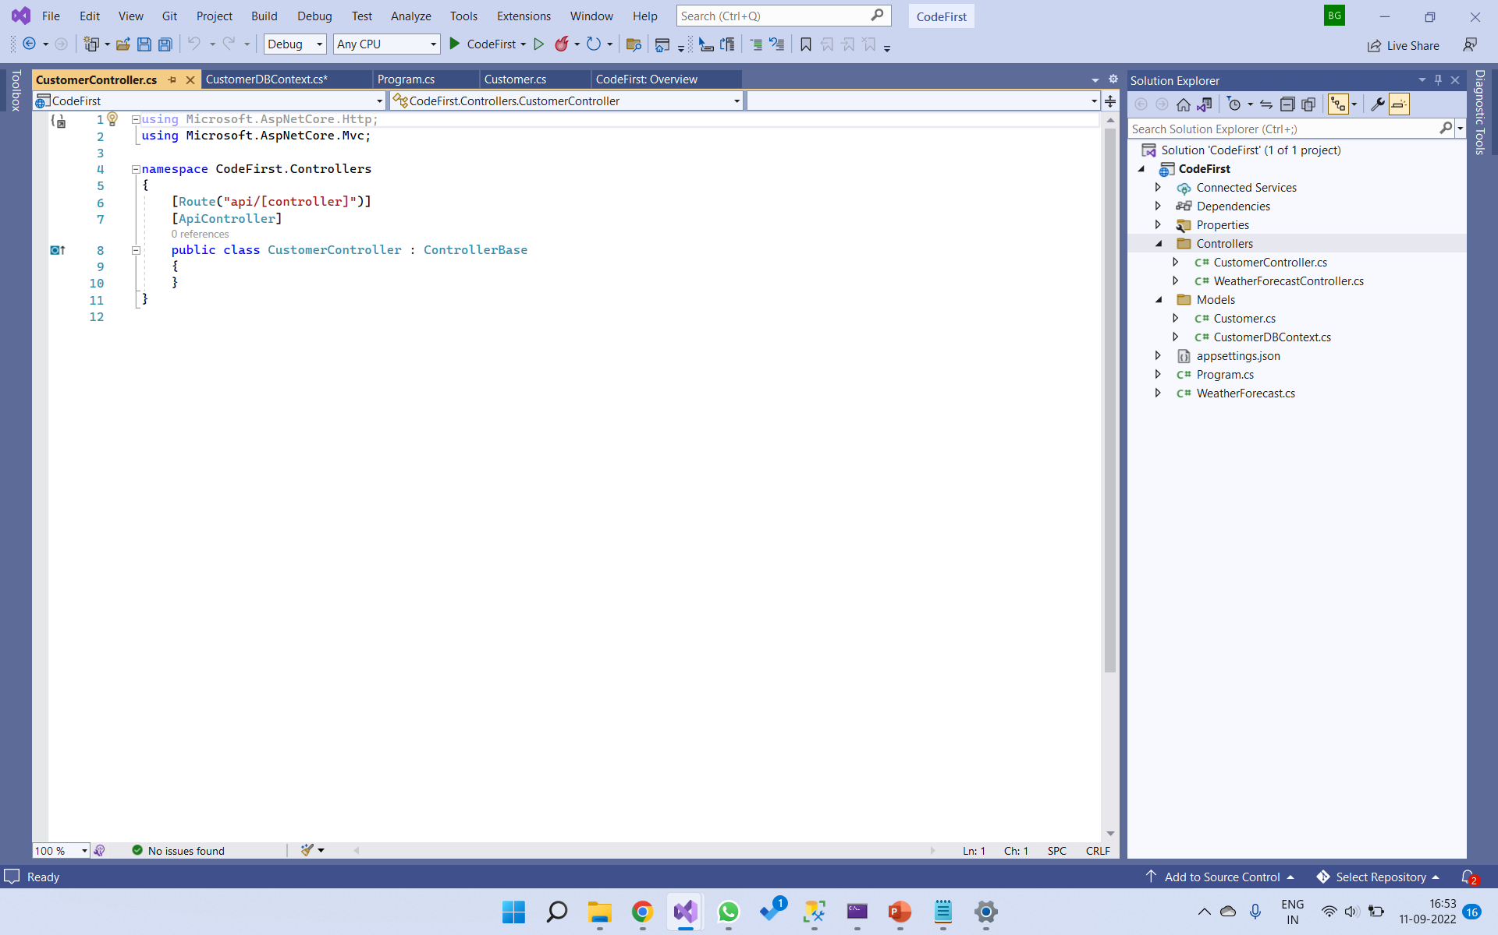
Description about code first approach
This is the CustomerController class. Now we need to add constructor to this class and pass the dbContext as a parameter as we have done dependency injection.

Slide 24
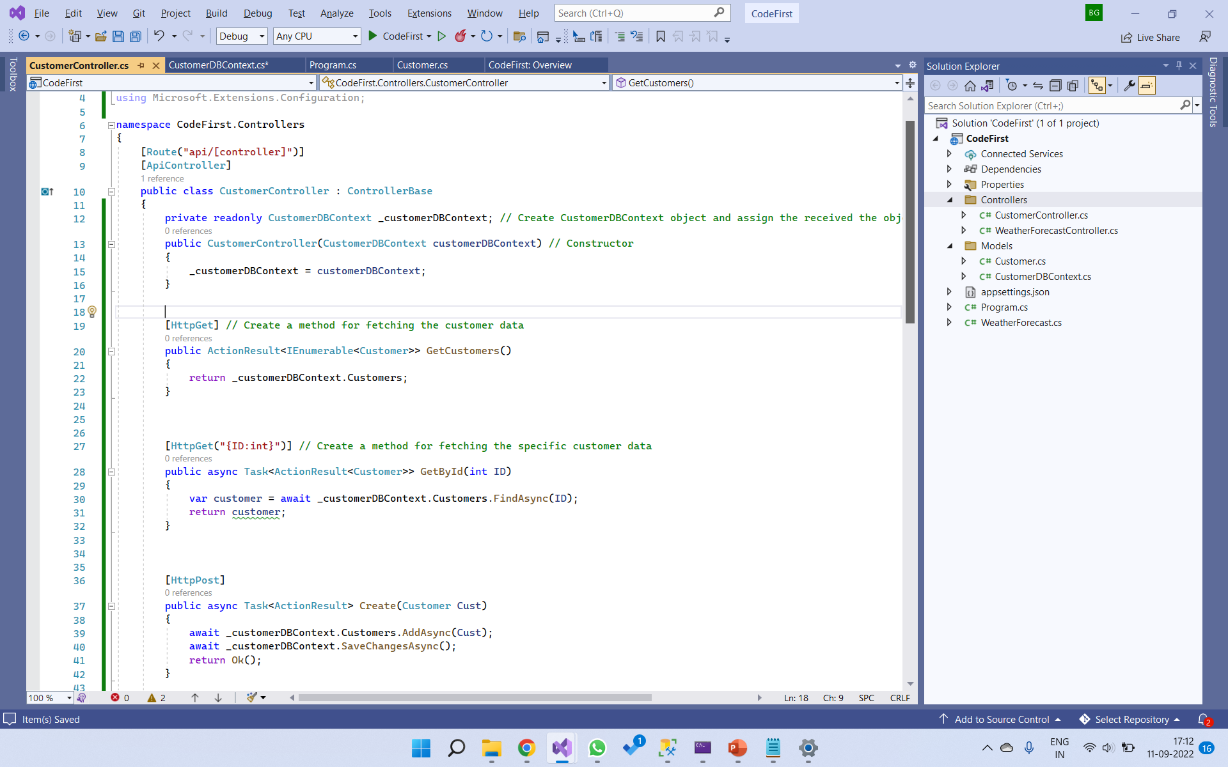
In the constructor, we are doing dependency injection of CustomerDBContext as a parameter and passing it to the CustomerDBContext object.
Creating methods to perform CRUD operations on the database table.

Slide 25
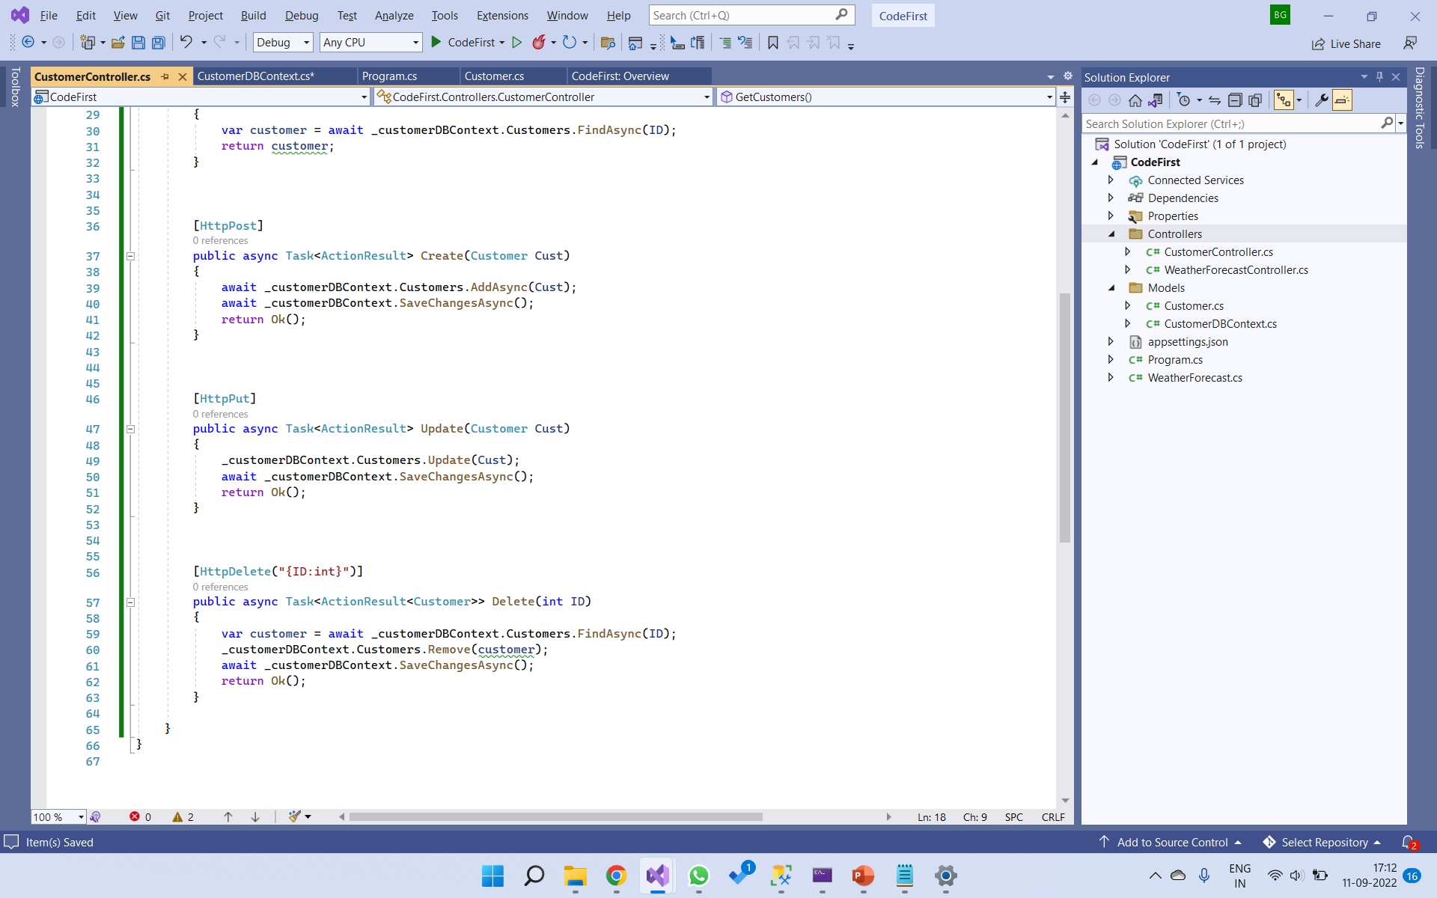

Slide 26
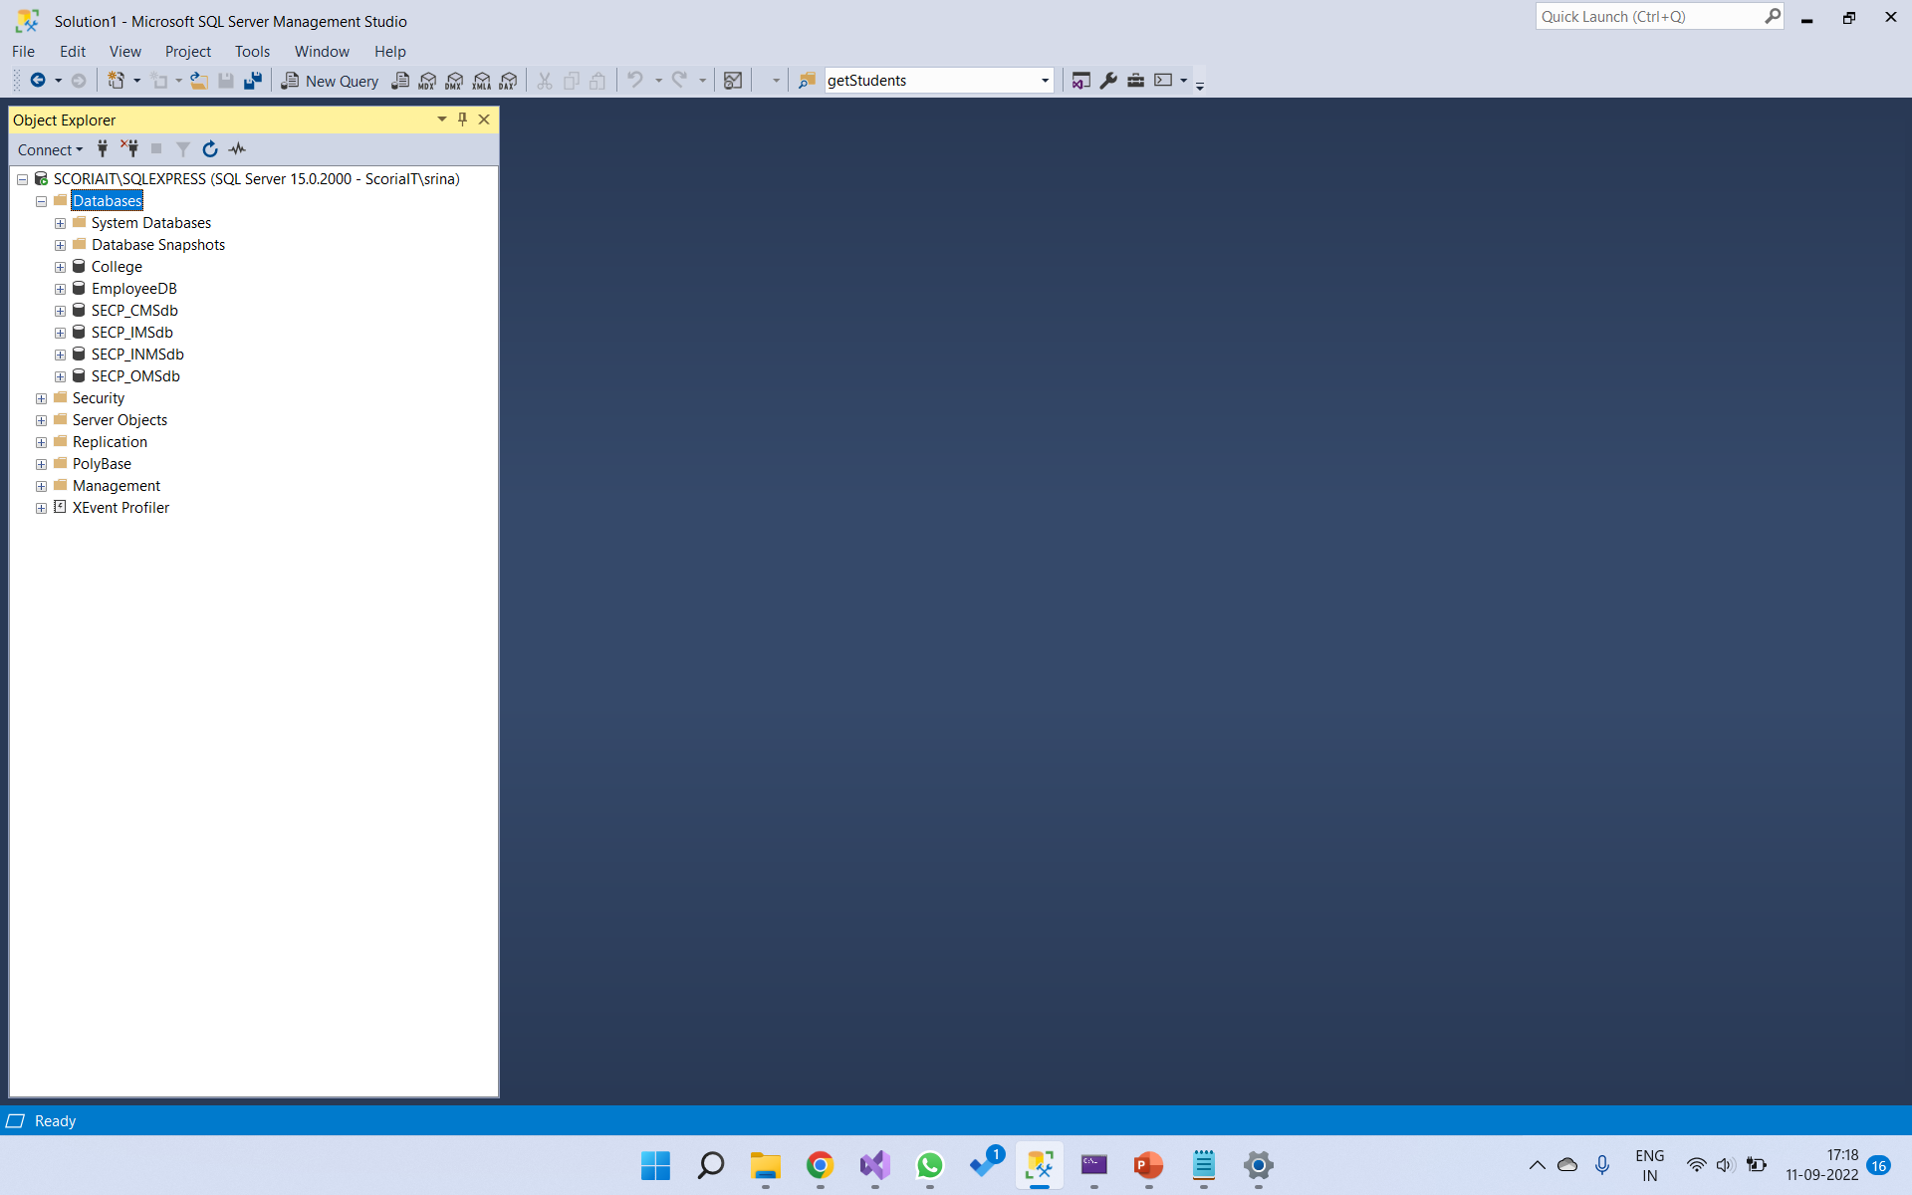
Now run your project.
After that check the MSSQL server to check the database.
There is no database with name CustomerDB

Slide 27
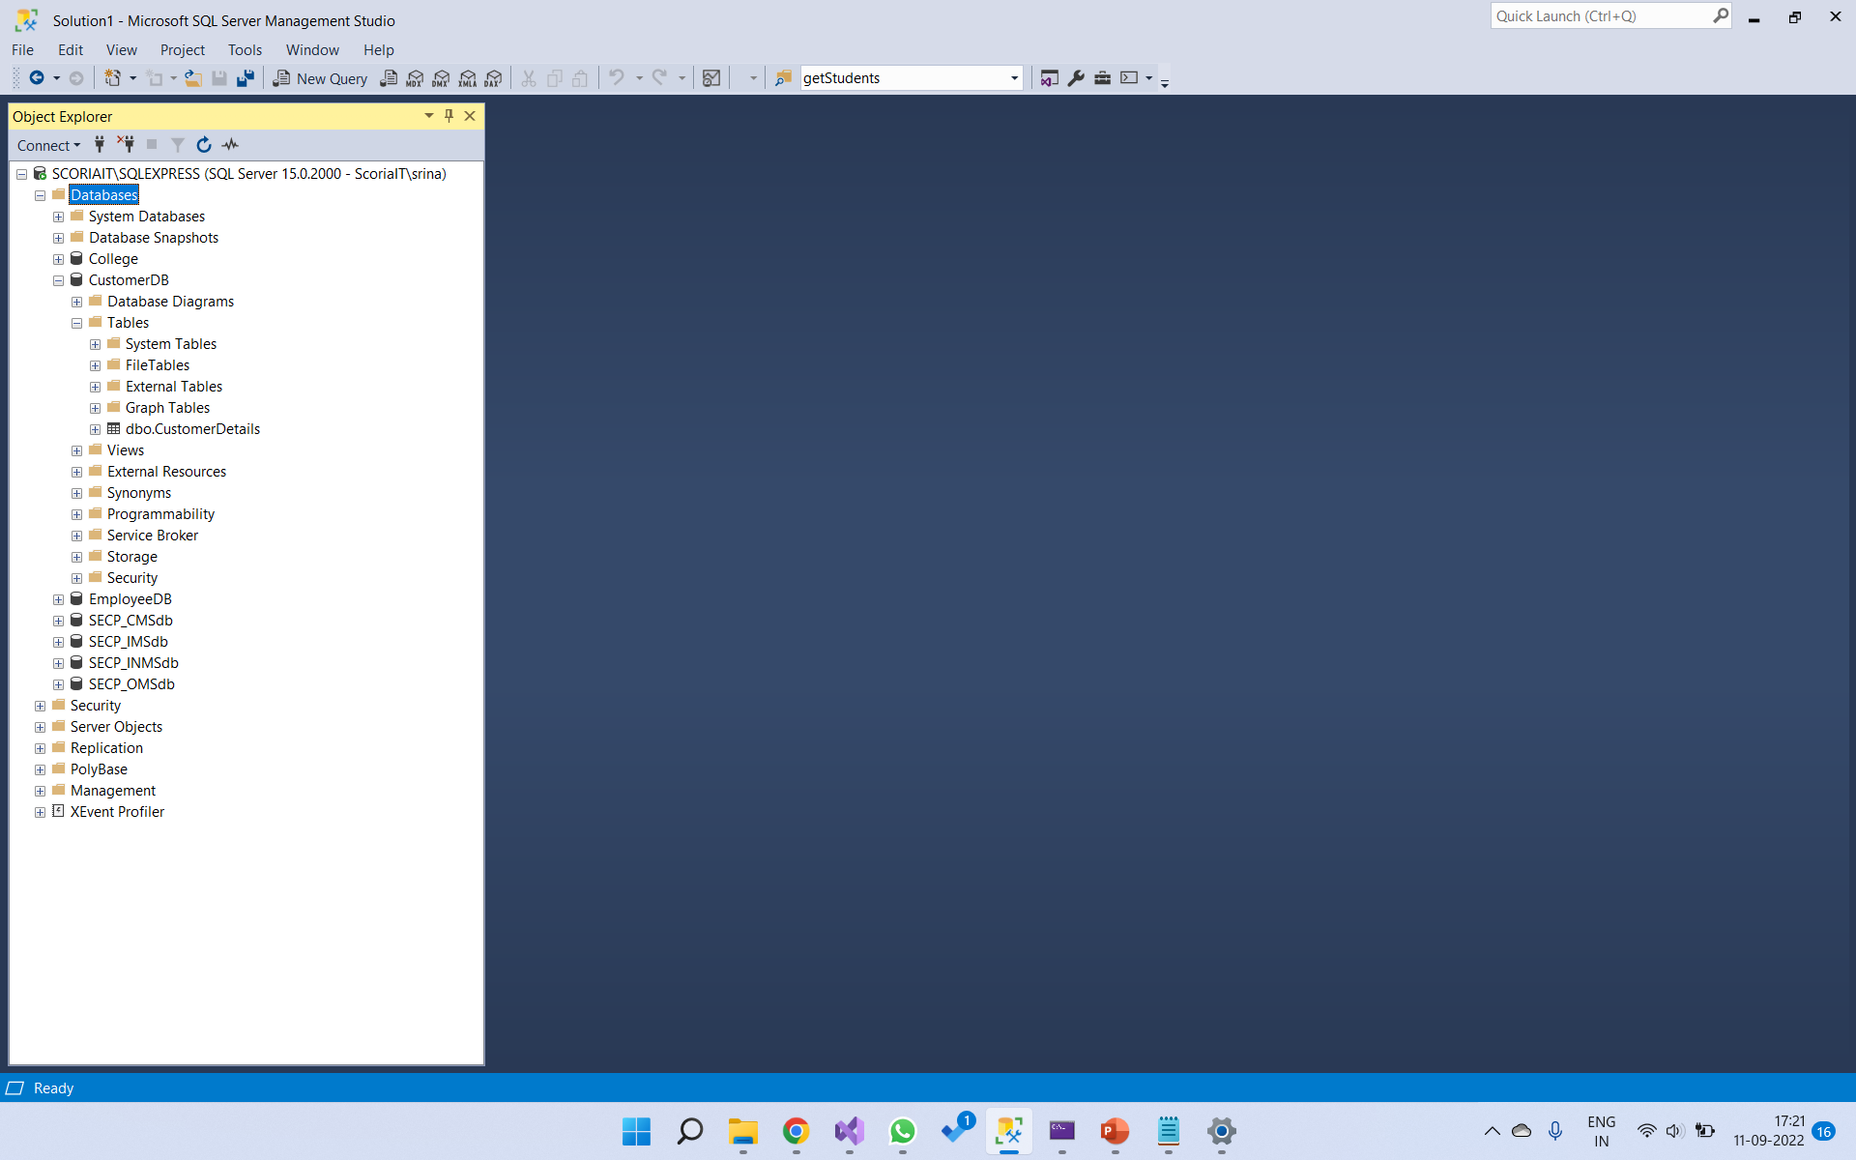
After successfully running your project, refresh the server. Now you’ll see the database and table has been created.
There is a database with name CustomerDB and table with name CustomerDetails

Slide 28
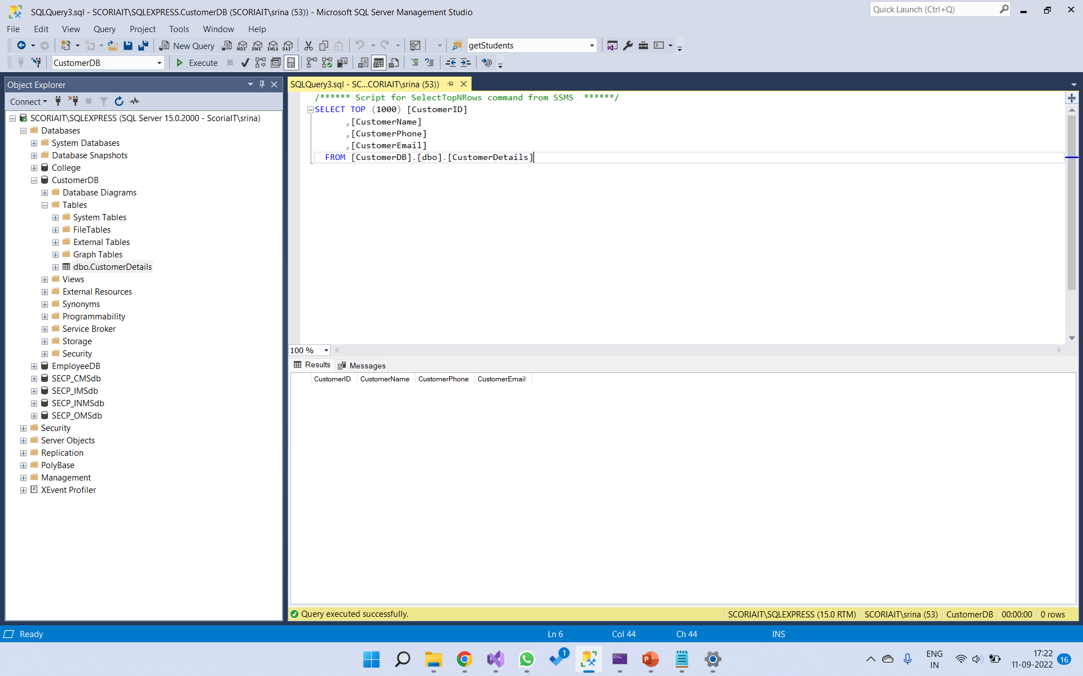
Now open your table.

Slide 29
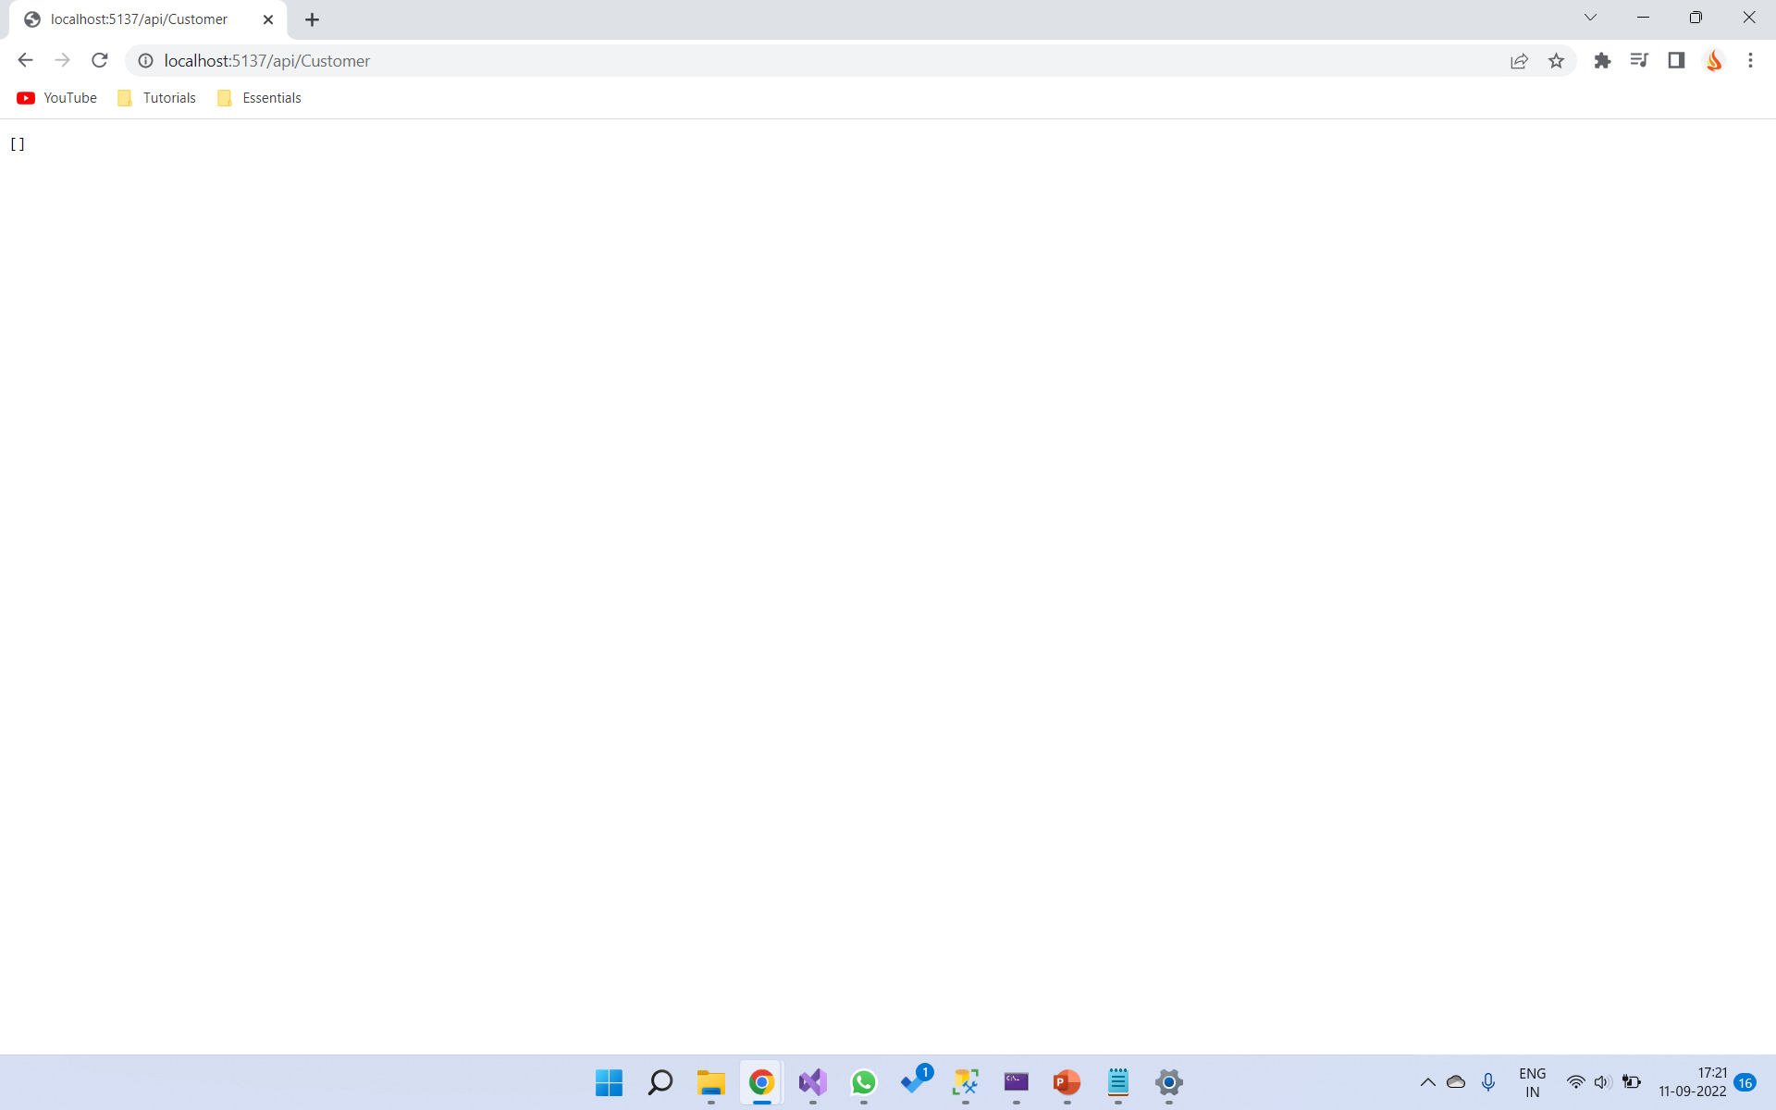
Now you need to open Postman and perform all CRUD operations. When you run the project, the initial output in the browser will be

